Slide 1

UNIVERSITY OF MESSINA
Department
Cognitive Science and Theory of Communication – LM-55
Course Title
SOCIAL SEMIOTICS
Teacher
Maria Rita Bartolomei
Mail: mabartolomei@unime.it

Slide 2

SOCIAL SEMIOTICS
Semiotics
Is the study of signs and symbols and their use or interpretation
Sign
has a referential function
anything which produces meaning and refers to something

Slide 3
SOCIAL SEMIOTICS
Sign
is the fundamental concept of semiotics
Semiotic resource
is the fundamental concept of social semiotics

Slide 4
SOCIAL SEMIOTICS
Just as in linguistics the focus has changed
from a “sentence” to a “text” and its “context”
and from “grammar” to “discourse”
Also in semiotics the focus has changed
from a “sign” to a “semiotic resource”

Slide 5
SOCIAL SEMIOTICS
The term “semiotic resource” originated in the work of Halliday
He described language
As a semiotic system and resource
As a “meaning potential”

Slide 6
SOCIAL SEMIOTICS
Halliday argued that the grammar of a language
is not a code
nor a set of rules for producing correct sentences
but a “resource” for making meaning

Slide 7
SOCIAL SEMIOTICS
Semiotic resources are
Cultural resources – values, rite, norms, texts, songs or actions –
which lead to a common understanding
Cultural resources are useful both
to produce communicative artefacts and events
and
to interpret them
in the context of specific social situations and practices

Slide 8
SOCIAL SEMIOTICS
Theo van Leeuwen defines semiotic resources as
the actions and artefacts we use to communicate
The term resource is preferred to sign because it
Avoids the impression that “what a sign stands for” is somehow pre-given and not affected by its use
Indicates that signs may not be divorced from the concrete forms of social interaction

Slide 9
SOCIAL SEMIOTICS
Semiotic resources are resources for making meaning
What are the resources for making meaning?
Mode is a socially-shaped and culturally-given semiotic resource for making meaning
There are many modes used in communication and representation: images, writing, layout, music, gestures, speech, moving images, 3D objects, etc.
Modes are the product of social work
Social work with the “same” material can lead to very different modes

Slide 10
SOCIAL SEMIOTICS
In communication, several modes are always used together:
image, writing, layout, music, gesture, speech, etc.
Different resources can be joined in multimodal ensembles
Each mode has a specific task and function
Writing names
Images show
Logos symbolise and inform
Colour frames and highlights

Slide 11


SOCIAL SEMIOTICS
In these posters we have four modes in the same sign:
writing, logos, images and colours

Slide 12
SOCIAL SEMIOTICS
All modes have equal significance in representation and communication
Each mode has its distinct potential for meaning
The signs can be different
in the mode used
in how the modes are used
Multimodality
Can tell us what modes are used
Cannot tell us about a difference in style and what that difference would mean

Slide 13
SOCIAL SEMIOTICS
Any semiotic resource – physical activity, object and artefact
has its own semiotic potential
Semiotic potential means the potential for making meaning
Each mode has its specific potential for making meaning
Each mode expresses meanings about states, relations, actions and events
in the world
Different modes offer different potentials for making meaning

Slide 14

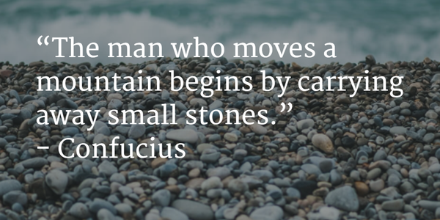
SOCIAL SEMIOTICS
“The man who moves a mountain begins by carrying away small stones”
Confucius

Slide 16
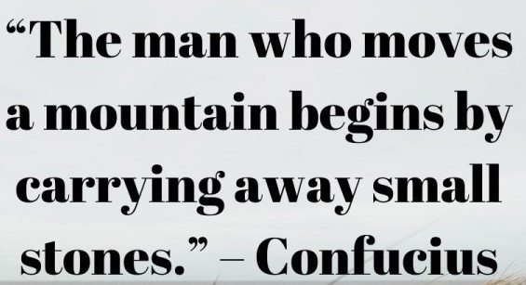
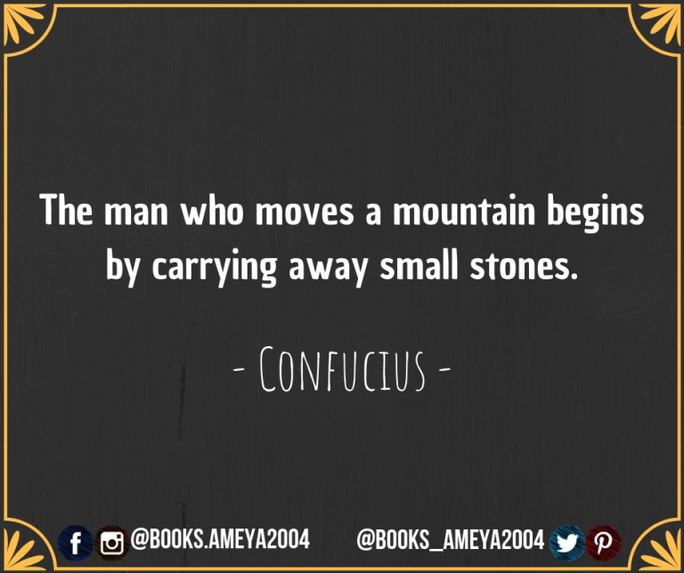
SOCIAL SEMIOTICS

Slide 17


SOCIAL SEMIOTICS
“The man who moves a mountain begins by carrying away small stones”
Confucius

Slide 18
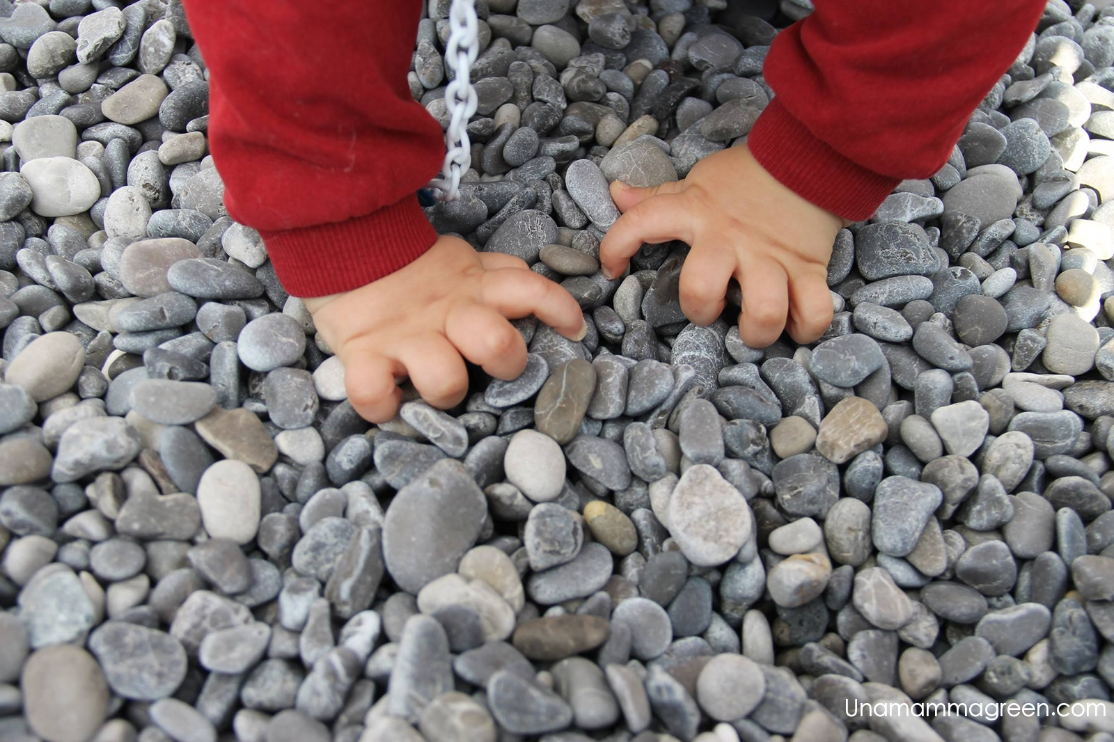
SOCIAL SEMIOTICS

